Slide 1
Library Management System Project

Slide 2
objective
The objective of this project is to design and implement a relational database for a library management system using MySQL. The database will manage information on about books, library members, and borrowing activities. It will also allow performing various queries to retrieve insights and support library operations.

Slide 3
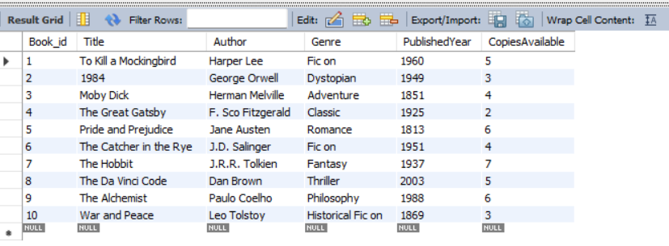
1. Retrieve all book details
select * from Books;

Slide 4

2. Find all members who joined after January 1, 2022
select * from Members where MembershipDate > '2022-01-01';

Slide 5
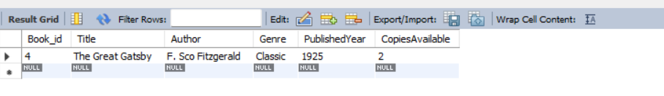
3. List the books that have fewer than 3 copies available
select * from books where CopiesAvailable < 3;

Slide 6
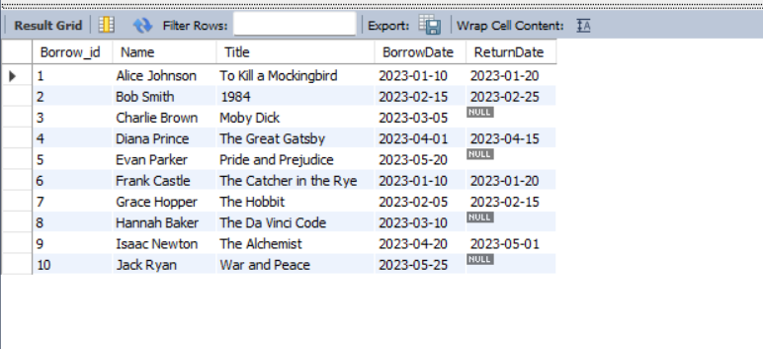
4. Show the borrowing history along with member names and book titles
select B.Borrow_id,M.Name,BK.Title,B.BorrowDate,B.ReturnDateFrom BorrowingTable B Join Members M ON B.Member_id = M.Member_id Join Books BK ON B.Book_id = BK.Book_id;

Slide 7

5. Identify overdue books (not returned by today's date)
select BK.Title,M.Name,B.BorrowDateFrom BorrowingTable B Join Books BK on B.Book_id = BK.Book_id Join Members M on B.Member_id = M.Member_id where B.ReturnDate is NULL AND B.BorrowDate < curdate();

Slide 8
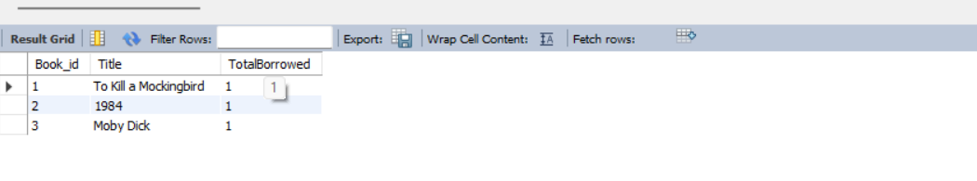
6. Show the top 3 most borrowed books
SELECT BK.Book_id,BK.Title,COUNT(*) AS TotalBorrowed FROM BorrowingTable B JOIN Books BK ON B.Book_id = BK.Book_id GROUP BY BK.Book_id, BK.Title ORDER BY TotalBorrowed DESC LIMIT 3;

Slide 9
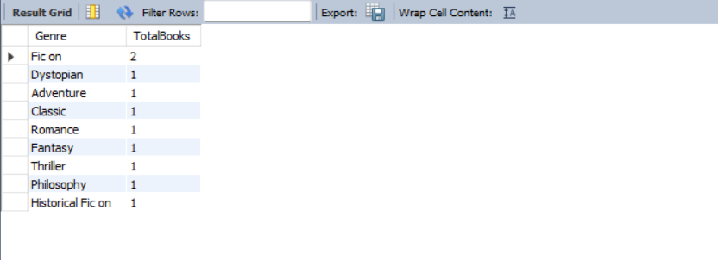
7. Display the total number of books in each genre
SELECT Genre,COUNT(*) AS TotalBooks FROM Books GROUP BY Genre;

Slide 10

8. Retrieve the borrowing history for a specific member (Member_ID = 3)
SELECT M.Name,BK.Title,B.BorrowDate,B.ReturnDate FROM BorrowingTable B JOIN Members M ON B.Member_id = M.Member_id JOIN Books BK ON B.Book_id = BK.Book_id WHERE M.Member_id = 3;

Slide 11

9. Calculate the average number of days books are borrowed before being returned
SELECT AVG(DATEDIFF(ReturnDate, BorrowDate)) AS AverageBorrowDays FROM BorrowingTable WHERE ReturnDate IS NOT NULL;

Slide 12

10. Find the least borrowed book
SELECT BK.Book_id,BK.Title,COUNT(B.Borrow_id) AS TimesBorrowed FROM Books BK LEFT JOIN BorrowingTable B ON BK.Book_id = B.Book_id GROUP BY BK.Book_id, BK.Title ORDER BY TimesBorrowed ASC LIMIT 1;

Slide 13
Thank you

